Slide 1
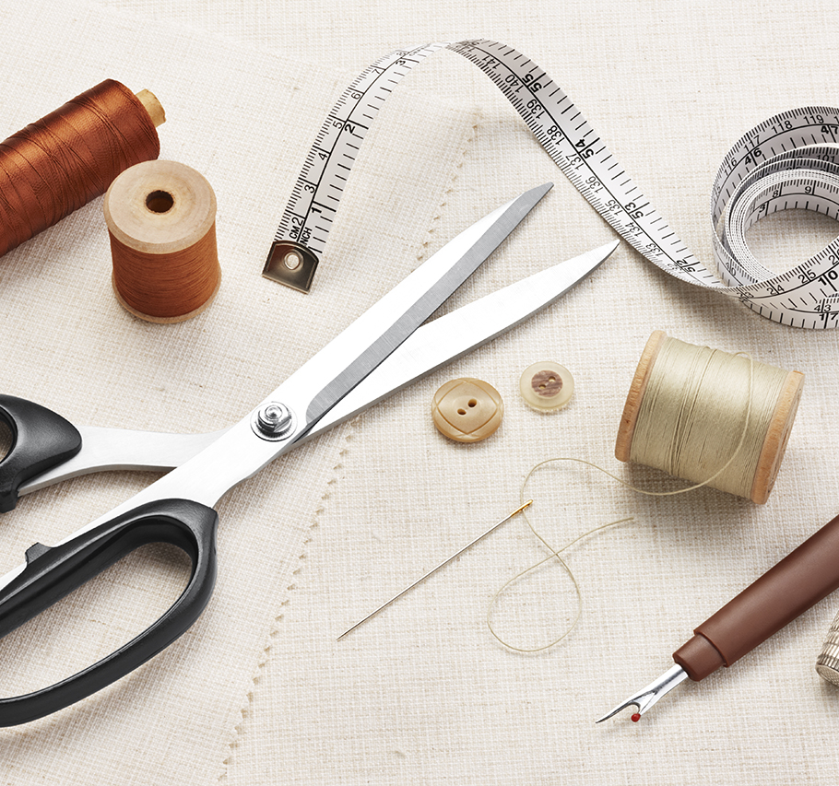
Goals, Principles, and Tools
10 February 2022

Slide 2

Goals

Slide 4
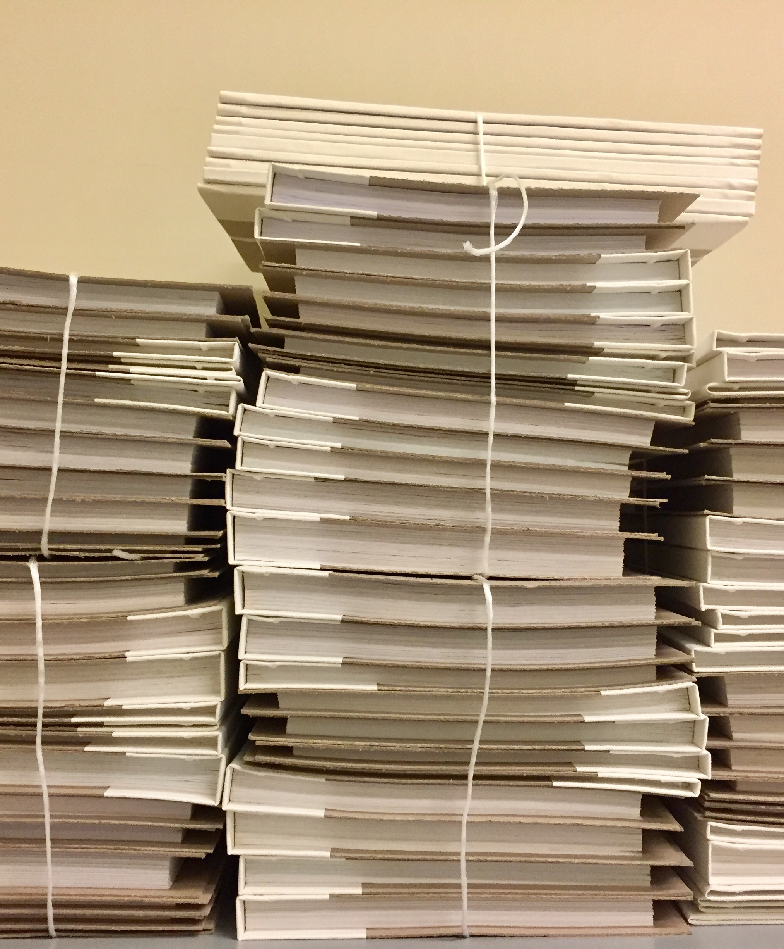
Principles

Slide 6

Break (10 minutes)

Slide 7
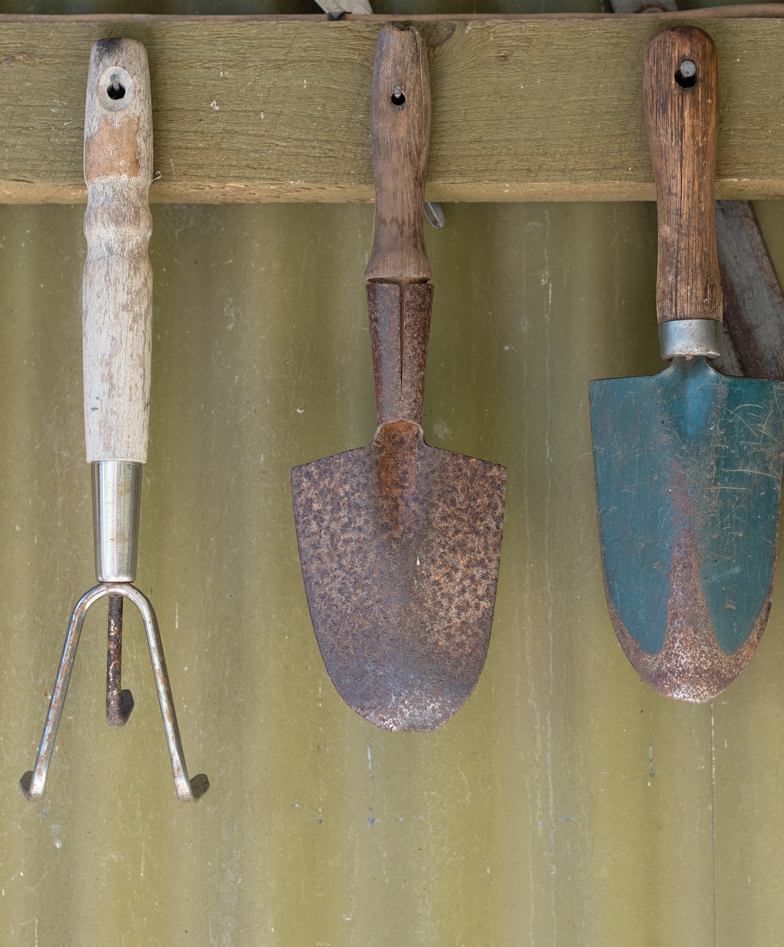
Tools

